Slide 1
Privacy
An ICS presentation by
Michael Acob, Cherryl Eckley,
Fatima Madriaga and Sean Studebaker

Slide 2
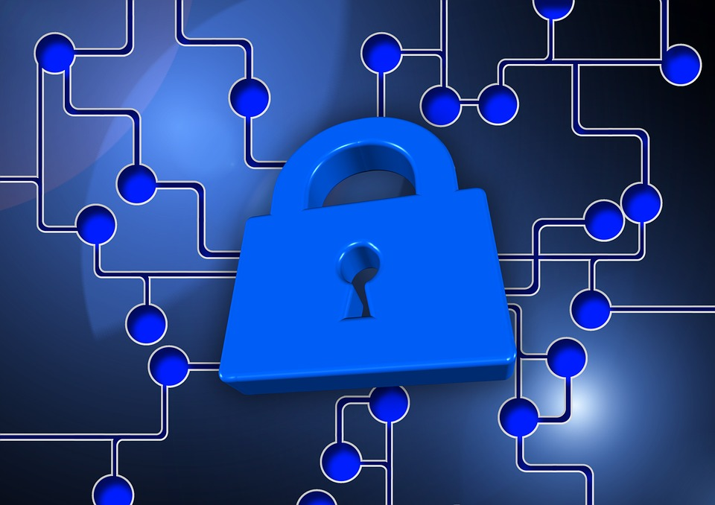
Introduction??
Introduction
“Privacy Policy Security” by geralt is licensed under CC0 Public Domain
Humanity is living in an era utilizing Information Technology (IT)
Information is a valuable resource in a competitive world
Acquiring information brings great advantages/power and vulnerabilities
Power/vulnerabilities include : cyber terrorism, cybercrime, cyber espionage, cyber warfare and erosion of personal privacy

Slide 3
Information Expansion with Technological Innovations
Advances in technology has made it possible for anyone at any age to access information for anything with the touch of a finger (IT)
Businesses can capitalize on this mode of exposure
Cloud computing, social media, mobile devices, computers
Greater marketing varieties, increased prosperity
Expanded opportunities for marketing strategies/education-based models
Potentials for introducing vulnerabilities
Information theft and leakage/identity theft

Slide 4
Business and Ethics in Internet Privacy
Data mining:
Collecting, sharing and selling online consumer activity and personal information
Public advertisement
Social, video and browsing engines like Facebook, Youtube, Google
These services default privacy policies are legal
Internet, cell and cable providers can legally mine WITHOUT PERMISSION
Public Ad’s aim at everyone as new users, they are unrelated to site content
Ad’s eventually fit to followers, subscribers, “likes” and history
Notes:
-Engines are the first data mining public advertisement services due to consumer accessible privacy policies
-default privacy policies do not notify you of your basic terms of use outside their agreements
-facebook default posts to everyone has been one of the biggest disputes, nearly everything including pictures and tags can be seen by everyone and defaults some personal information like contact info and addresses to friends

Slide 5
Cyberterror, Cyber War, and Cyber Crime
Cyberterror- use of computers and information to cause disruption or fear in society
Cyber War- use of computer technology to disrupt the activities of a state or organization
CyberCrime- criminal activities carried out by means of computers or the Internet
Vulnerabilities
Terrorists are becoming more computer savvy
Identity thief, hacking, cyber stalking
Nations are left to create their own defenses against this

Slide 6
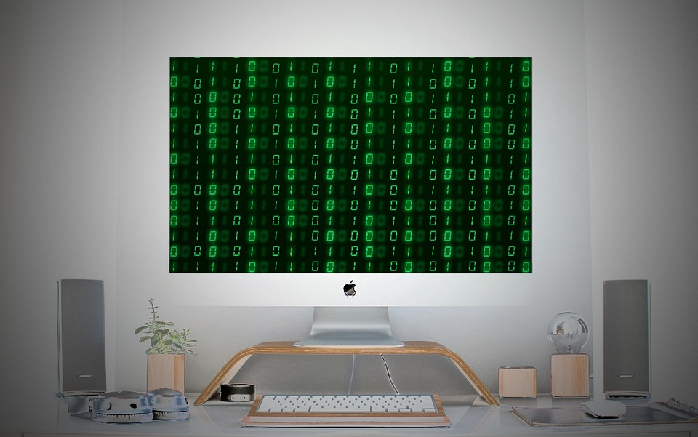
Erosion of Personal Privacy
The invasion of personal privacy affects everyone
Technology has become a nasty business
Beware of information brokers
Government point of view: lack of privacy becomes an advantage to track illegal activity
Without strict security measures, innocents could become victims
“Cyber Security” by typographyimages licensed by CC0 Public Domain

Slide 7
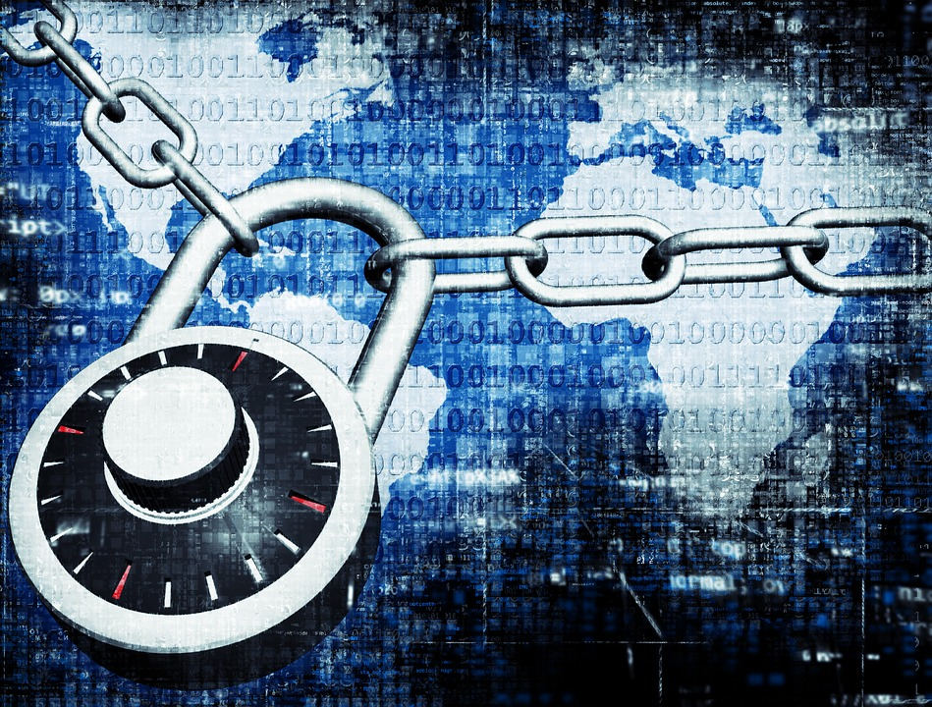
Position
Information technology is an amazing tool
Humanity has access to the largest information database in recorded history
Monumental responsibility handling information impeccably
Information is a two-edged sword, how we wield it depends on how our lives will be impacted in the end
“Privacy Technology” by HypnoArt is licensed by CC0 Public Domain

Slide 8
Summary
On October 26, 2001 President George W. Bush signed into law the USA Patriot Act which allows the government to secretly request and obtain library, IT and other records for large numbers of individuals without any reason to believe they are involved in illegal activities. On June 1, 2015 after the Act expired, the USA Freedom Act was passed into law to renew the expired parts until 2019.
Technology is here to stay….
Education, using caution, remaining informed about the benefits and dangers of navigating the IT highway can help to eliminate the privacy risks of communicating in a technologically advanced society.
Website: www.icsprivacyproject.weebly.com
Notes:
Uniting and Strengthening America by Providing Appropriate Tools Required to Intercept and Obstruct Terriorism

